Slide 1
BUYING/SELLING AIRCRAFT
AS405

Slide 2
Selling an aircraft
Reaching List Price
(IN ORDER OF VALUE)
Logbooks
Total Time
SMOH
Age
Inspections
ADs/SBs/ACs/MSBs
Avionics
Interior
Paint

Slide 3
Selling an aircraft
INSPECTIONS
Annual
Progressive
135
121
Pitot Static
Mode C/S
Time Limited Items
Life Limited Items

Slide 4
Selling an aircraft
MANDATORY COMPLIANCE
Airworthiness Directives
Service Bulletins
Advisory Circular
Mandatory Service Bulletin
LINKING ADs

Slide 5
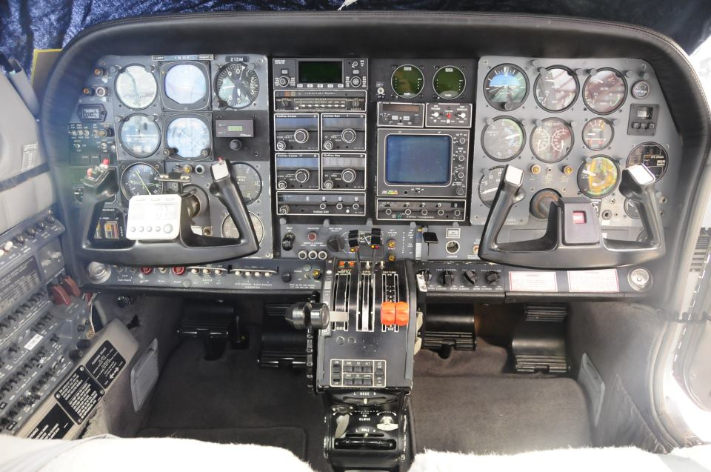
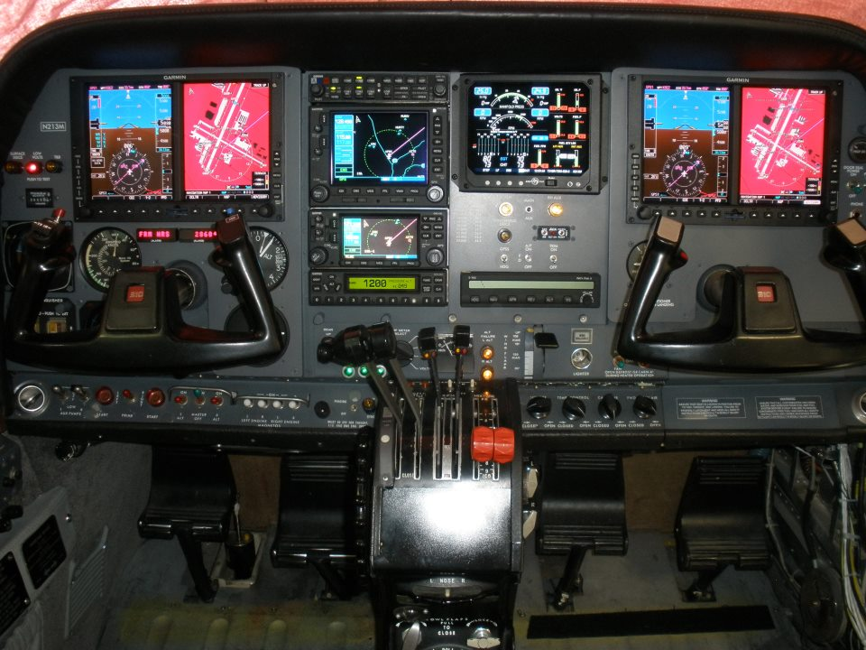
Selling an aircraft
AVIONICS
What is worth more?
A
B

Slide 6
Selling an aircraft
AVIONICS
What is worth more?
DEPENDS ON
THE PLANE!!!

Slide 7
Selling an aircraft
PAINT & INTERIOR
Sliding Scale 1-10
1- Never Seen It
5- Needs P&I Badly
7- About Average
10- What EVERYONE Sells (exists in fairy tales)
Interior Cost: $14,000 (Cessna 310)
Paint Job: $18,900 (Cessna 310)

Slide 8
Selling an aircraft
SAMPLE LISTINGS
1964 CESSNA 310I
4400 TT
145 L/R SMOH
90 SPOH
NO FANCY AVIONICS
P&I: 7
NO ADVERSE MX

Slide 9
Selling an aircraft
SAMPLE LISTINGS
1964 CESSNA 310I
4400 TT
1450 L/R SMOH
900 SPOH
NO FANCY AVIONICS
P&I: 7
NO ADVERSE MX

Slide 10
Selling an aircraft
FALSE REPRESENTATION
CYA
DUE DILIGENCE
LOGBOOKS

Slide 11
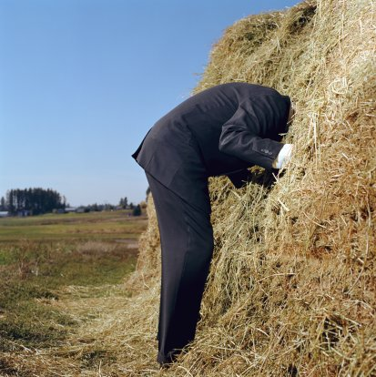
buying an aircraft
THE SEARCH

Slide 12
buying an aircraft
THE SEARCH

Slide 13
buying an aircraft
PROCEDURE
Financing
Title Search
Verify
Negotiations
Valuations
Pre-Purchase Inspection
Corrections
Bank Forms & Verification

Slide 14
buying an aircraft
Financing
Find Appropriate Bank
Provide Documentation
Understanding Asset Limitations

Slide 15
buying an aircraft
PROCEDURE
Financing
Title Search
Verify
Negotiations
Valuations
Pre-Purchase Inspection
Corrections
Bank Forms & Verification

Slide 16
buying an aircraft
Pre-Purchase Inspection
Logbook Review
Time Verification
STC, 337, 8130s
AD/SB/AC/MSB
Condition of the Aircraft
Airworthiness
Corrections List
Deferment
Airworthiness

Slide 17
buying an aircraft
Corrections
Deferment Items
Reasonable
Unreasonable
Airworthiness Items
Negotiations (Round 2)

Slide 18
buying an aircraft
BANK FORMS & VERIFICATION
Formal Appraisal
8050-98 Security Form
Master Promissory Note
Lien File

Slide 19
Selling / buying an aircraft
CLOSING
Warranties
8050-1 Registration
8050-2 Bill of Sale

Slide 20
Selling / buying an aircraft
LEASEBACK
DON’T EVER
DO IT!!!!!!

Slide 21
Selling / buying an aircraft
LEASE
Split Costs
Larger Aircraft for Less
Flexibility
Diverse Fleet
Multiple Aircraft
Structured is Best
NetJets
Hard to Finance
Generally Factory New

Slide 22
Selling / buying an aircraft
ESCROW
Completely Optional
Slow Down Transaction
Can File Appropriate Paperwork
Title Searches
Lien Payoff

Slide 23
Selling / buying an aircraft
BROKERS
Speed Up Transactions
Appraisals
Fees Associated
Buying- Flat Fee or %
Selling- %
Negotiate on Your Behalf
Can Navigate the Paperwork
Know What to Investigate
Network of Professionals

Slide 24
Selling / buying an aircraft
LITIGATION
Unable to Deliver
Contracts
Damages (Loss of Profit, Remedies)
False Representation
Remedy Situation
Forged Documents

Slide 25
Selling / buying an aircraft
BILL OF SALE
Other Considerations
Price
Risks
Tax Fraud
Paper Trails
Legitimate Considerations

Slide 26
Selling / buying an aircraft
RECENT CHANGES
Registration of Aircraft
Re-Registration
Location of Delivery
Tax Purposes
Expired Registrations
Let it Go…Let it goooo
Rolling Dates

Slide 27
Disclaimer: No feds, cops, irs, lawyers, you get the drift….
Beyond this point is questionably ethical.
These are “schemes” commonly used
They can cause issues with future litigations, tax issues, and headaches.
This is just “FYI”

Slide 28
Selling / buying an aircraft
TAXES….
Sales Tax
California
Texas
Oregon
Property/Luxury Tax
Arizona
California
Loopholes
Other Considerations

Slide 29
Selling / buying an aircraft
TAXES….
Capital Gains
Operational Taxes
Arizona Tag
Best States
Delaware

Slide 30
Selling / buying an aircraft
TIPS/TRICKS
Original Documents
Blue Pen
FAA Provided
OMB Form
Carbons
Delivery Confirmation
CASH!

