Slide 1
Topic of the Month October
Compliance Philosophy
<Audience>
<Presenter>
< >
Notes:
2016/06/17-086 (I) PP Original Author: J.B. Williams AFS-850, Phone 559-473-7144 (04/14.2016); POC : K Clover, AFS-850, Phone 562-555-8080; Reviewed by J. Steuernagle 562-264-5484.
Presentation Note: This is the title slide for (Compliance Philosophy)
Presentation notes (stage direction and presentation suggestions) will be preceded by a Bold header: the notes themselves will be in Italic fonts.
Program control instructions will be in bold fonts and look like this: (Click) for building information within a slide; or this: (Next Slide) for slide advance.
Some slides may contain background information that supports the concepts presented in the program.
Background information will always appear last and will be preceded by a bold Background: identification.
We have included a script of suggested dialog with each slide. Presenters may read the script or modify it to suit their own presentation style.
The production team hope you and your audience will enjoy the show. Break a leg!
(Next Slide)

Slide 2
Welcome
Exits
Restrooms
Emergency Evacuation
Breaks
Sponsor Acknowledgment
Set phones & pagers to silent mode or off
Other information
Notes:
Presentation Note: Here’s where you can discuss venue logistics, acknowledge sponsors, and deliver other information you want your audience to know in the beginning.
You can add slides after this one to fit your situation.
(Next Slide)

Slide 3
Overview
Compliance Philosophy
What is it?
Improving Safety by Fixing the Problem
Compliance Actions – Willing and Able
On the Spot Correction
Counseling
Additional Training
Remedial Training
Education
Improvements to systems, procedures, and training programs
What does the Compliance Philosophy mean to airmen?
Summary
Notes:
The purpose of this presentation is to provide a high level overview of the FAA Compliance Philosophy. We will cover what the Compliance Philosophy is, why it was adopted and how the program is administered. We will also cover the Remedial Training Program and how the FAASTeam interacts with airmen or organizations who have accepted Remedial Training as a mitigating ‘fix’ to a regulatory deviation.
(Next Slide)

Slide 4
Compliance
What is it anyway?
Philosophy
Notes:
What is the FAA Compliance Philosophy? Has the way the FAA looks at regulatory compliance really changed? You may have viewed the FAA as police whose only job was to write violations and catch airman violating the Federal Aviation Regulations. After this presentation your view of how the FAA looks at safety may change dramatically. So, I’m sure your asking, “what is the Compliance Philosophy anyway?”
Next Slide

Slide 5
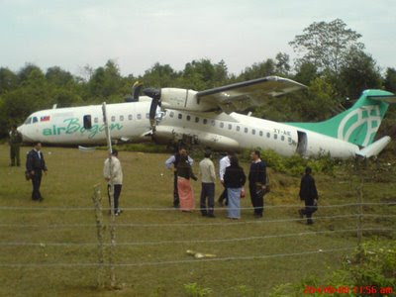
Compliance Philosophy Goal
Find
Notes:
What is the FAA Compliance Philosophy? Simply put, the goal of the Compliance Philosophy is to identify safety issues that underlie deviations from standards and correct them as effectively, quickly, and efficiently as possible.
That means collaborating with the aviation community to share information about safety issues that underlie deviations from standards. Errors must be identified, reported, and analyzed in a non-blaming manner so that appropriate remedial or system-wide corrective action can be taken based on the specific facts and circumstances of each case.
Next Slide

Slide 6
Improving Safety
The responsibility for aviation safety does not rest entirely with the FAA. All airmen, air carriers, aircraft owners and operators, air agencies, and certain airport operators who qualify for and accept an FAA certificate have statutory or regulatory safety duties.
The safety of our National Airspace System (NAS) is based on each individual certificate holder’s (that’s you) duty and responsibility to provide for public safety.
The high level of safety in the NAS is largely based on, and dependent upon, voluntary compliance with regulatory standards.
Notes:
The Compliance Philosophy is all about improving SAFETY. Our safety record shows that the majority of NAS participants have a good safety culture. The success of FAA voluntary programs such as the Aviation Safety Action Program (ASAP) and Voluntary Disclosure Reporting Program (VDRP) has demonstrated that a collaborative compliance philosophy, supported by a positive safety culture, provides the highest levels of compliance with regulations, the most effective identification of hazards, and the most efficient management of risks.
Next Slide

Slide 7
Improving Safety (cont.)
To promote the highest level of safety and compliance with regulatory standards, the FAA is implementing Safety Management System constructs based on comprehensive safety data sharing between the FAA and the aviation community.
To foster this open and transparent exchange of data, the FAA believes that its compliance philosophy, supported by an established safety culture, is instrumental in ensuring both compliance with regulations and the identification of hazards and management of risk.
Notes:
To foster this open and transparent exchange of information, we must understand the difference between accountability, which accepts responsibility and looks forward, and blame, which focuses on punishment for what has already occurred. Key to a just safety culture is the ability to determine where the line should be drawn between blameless unsafe acts that can be effectively addressed through use of compliance tools and unacceptable behavior that requires use of enforcement action.
Next Slide

Slide 8
Fix The Problem
When deviations from regulatory standards do occur, the FAA's goal is to use the most effective means to return an individual or entity that holds an FAA certificate (you), approval, authorization, permit or license to full compliance and to prevent recurrence.
The FAA recognizes that some deviations arise from factors such as flawed procedures, simple mistakes, lack of understanding, or diminished skills. The FAA believes that deviations of this nature can most effectively be corrected (fixed) through Root Cause Analysis, Education, Training, On-The-Spot-Corrections, Counseling, or other appropriate improvements to procedures or training.
Notes:
Find the problem, identify the most effective solution and implement the fix to ensure the event does not happen again. So to find the right “fix” for the problem, we must look at the “Root Cause” of the problem.
Next Slide

Slide 9
Root Cause
Fixing root causes is the best way to prevent recurrence. In the majority of cases, finding and fixing safety problems in all parts of the NAS can be done most effectively with a collaborative approach and the voluntary participation of all parties involved.
Aviation Safety Inspectors (ASI) are focused on problem-solving, correctly identifying root causes, and recommending appropriate corrective actions to adequately mitigate the risks involved.
Notes:
The FAA Compliance Philosophy requires FAA personnel to engage in a solution-oriented, outcomes-based approach to identify safety issues and correct noncompliance. The FAA Aviation Safety Inspectors use interdependence and critical thinking to evaluate the discrete facts of a particular situation, and then choose the best tool to fix the problem, consistent with regulations, policies, and the specific circumstances of each event.
Follow-up is used to validate that the desired corrective actions were taken, and that they had the intended outcome for safety and compliance. This view of compliance stresses a problem-solving approach where enhancement of the safety performance of individuals and entities is the goal. This approach will more effectively address inadvertent deviations and conserve FAA enforcement resources for intentional, reckless, criminal, and uncooperative behavior. If the deviation does not involve intentional, reckless, or criminal behavior and the airman/organization is qualified and willing to cooperate, the FAA should resolve the issue through use of Compliance Actions.
Next Slide

Slide 10
Compliance Action
In a nutshell:
The Compliance Philosophy allows for the use of less stringent means (compliance actions) to gain compliance, when an airman is willing and able to take corrective action.
Compliance Philosophy
Notes:
In most cases, a violation is the last resort when an airman is not “Willing” or “able” to take corrective action.
Next Slide

Slide 11
Willing & Able
The individual must be “willing.”
Acknowledges Responsibility
Shares Information to help determine Root Cause
Promptly Implements Corrective Action
The individual must be “able.”
Possess the Time & Resources to Correct the Deviation
Has the Ability to Develop Technical Competence through Corrective Action
Has access to data, equipment, facilities, etc. to comply with regulatory requirements and appropriately manage risk.
Notes:
The FAA must consider several factors that make an airman or organization a good candidate to recommend a Compliance Action as a solution to a regulatory deviation. The Presenter will cover the elements in the slide and can add some practical examples. A key element here is that the person must be willing and able to meet the standards of the certificate they hold.
Next Slide

Slide 12
What are Compliance Actions?
Compliance Action is a new term to describe the FAA’s collection of non-enforcement methods to correct unintentional deviations or noncompliance that arise from factors such as flawed systems and procedures, simple mistakes, lack of understanding, or diminished skills.
A Compliance Action is not an Adjudication and does not constitute a finding of Violation.
Notes:
A Compliance action is not a Adjudication or finding of a violation. It is an action taken by the FAA to address a deviation from regulatory standards through other than legal means. It is a proactive approach to finding and fixing a safety issue/concern.
Next Slide

Slide 13
Compliance Action (cont.)
For violations resulting from flawed procedures, simple mistakes, lack of understanding, or diminished skills:
On-the-spot correction
Counseling
Additional Training
Education
Improvements to systems, procedures, and training programs
Notes:
Cover the Compliance Actions that might be used to fix a problem and bring the airman or organization back into compliance and prevent a reoccurrence. We will discuss these Compliance Actions next.
Next Slide

Slide 14
On The Spot Correction
Corrective action completed immediately by the certificate holder when a deviation from statutory or regulatory standards is identified by the FAA and communicated to an individual or company
Notes:
Define ‘On The Spot Correction’.
Next Slide

Slide 15
Counseling
Oral or written counseling of airmen, organizations, or non-certificated National Airspace System (NAS) participants, for a safety concern or a deviation from statutory or regulatory standards
Notes:
Used for a minor issue that does not require a more extensive training program or Compliance Action. The idea of counseling is to make the airman aware of the mistake they made and how to prevent it in the future.
Next Slide

Slide 16
Additional Training
Additional Training can include an individual’s own organizational approved training program.
Other required training programs for an individual’s job function or work environment (such as carrier employees receiving SIDA or ramp driver training from the airport).
Remedial Training. A program that may be used for some certificated airmen when remedial training is the appropriate action to take for a deviation from statutory or regulatory standards.
Notes:
Explain the different ways Additional Training can be applied to correct a Compliance Issue.
Next Slide

Slide 17
The FAASTeam & Remedial Training (RT)
The goal of the RT program is to gain future compliance with FAA regulations through training, thereby enhancing safety in the National Airspace System (NAS).
SAFETY #1
Notes:
The FAASTeam manages the Remedial Training programs within the FAA. Remedial Training is assigned by the FAA Investigating Inspector and the FAASTeam Program Manager (FPM) is responsible for creating a training syllabus for the airman and monitoring the progress of the training. The FAA does not conduct any of the training, but rather ensures the proper training is conducted and completed successfully.
Next Slide

Slide 18
Remedial Training Basics
Airman must:
Agree to RT and Sign the Remedial Training Agreement
Bear all cost associated with Remedial Training
Use an Approved Training Providers or submit an acceptable alternative Training Provider
Complete the training program within a timely manner (generally 30 days).
Notes:
The idea here is to make all parties aware that RT is a voluntary program and the airman or organization must agree to participate and accept all costs associated with completing the training recommended. They must also successfully complete the program or face other Compliance Actions or possibly enforcement.
Next Slide

Slide 19
Education
The FAA promotes education through public awareness programs and other aviation educational efforts:
FAASafety.gov
WINGS Program
AMT Program
FAA Safety Seminars and Webinars
FAA Safety Briefing Magazine
Notes:
Discuss the different education outreach programs available to airman and organizations.
Next Slide

Slide 20
Improvements to Systems, Procedures & Training Programs
Usually applies to pilots who may be part of an organization that uses company systems and procedures.
The company or organization may also have a training program.
Improvements to these systems, procedures or training programs may need to be made to ensure they do not conflict with regulatory requirements and safe operating procedures.
Notes:
If a pilot belongs to an organization or company that conducts flight operations under their company procedures and training, the problem may be in these areas versus directly with the airman. Under these circumstances, the corrective action may be to make improvements to the Systems, Procedures & Training Programs to prevent a reoccurrence of the event.
Next Slide

Slide 21
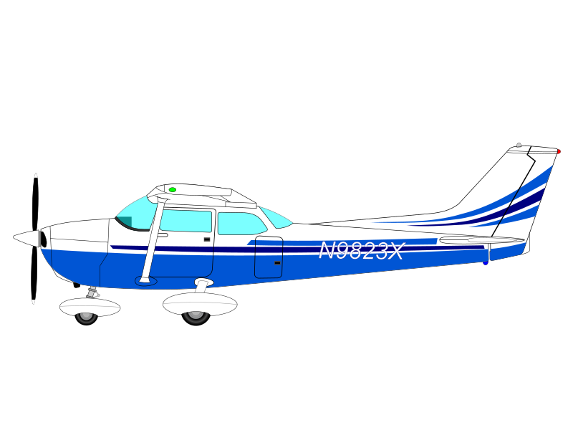
What does this mean to you?
The FAA will use a Compliance Action as the initial means of addressing all alleged, suspected, or identified instances of noncompliance with a rule or deviations from standards or procedures until a determination is made that a Compliance Action is not appropriate.
Notes:
If you’ve made an honest mistake, a temporary lapse of judgment or have let your skills become rusty, you may be able to ‘fix’ the problem without facing a violation.
Next Slide

Slide 22
In Summary
A Safe National Airspace System (NAS) is achieved through a culture of mutual trust and transparency. The Compliance Philosophy is ultimately a Just Culture philosophy.
Instead of chastising airmen/organizations for an inadvertent deviation, it centers on gathering data from those deviations to predict and prevent future occurrences.
The Compliance Philosophy does not preclude the enforcement of intentionally reckless behavior, falsification or repeated failures.
Notes:
The Compliance Philosophy is primarily a process to identify the root cause of a safety issue, find a ‘fix’ and monitor the success of that ‘fix’. With the data collected from this process, the FAA hopes to predict and prevent future occurrences through education, training and improvement to systems and processes.

Slide 23
Questions?
Notes:
Presentation Note: You may wish to provide your contact information and main FSDO phone number here. Modify with
Your information or leave blank.
(Next Slide)

Slide 24
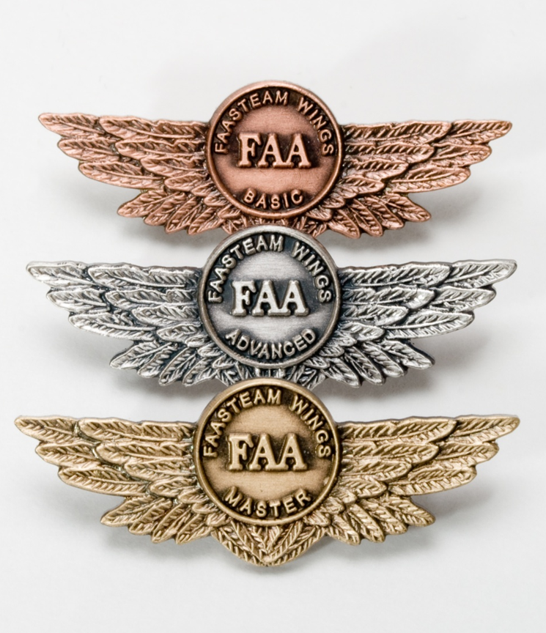
Proficiency and Peace of Mind
Fly regularly with your CFI
Perfect Practice
Document in WINGS
Notes:
There’s nothing like the feeling you get when you know you’re playing your A game and in order to do that you need a good coach (Click)
So fly regularly with a CFI who will challenge you to review what you know, explore new horizons, and to always do your best. Of course you’ll have to dedicate time and money to your proficiency program but it’s well worth it for the peace of mind that comes with confidence. (Click)
Vince Lombardi, the famous football coach said, “Practice does not make perfect. Only perfect practice makes perfect.” For pilots that means flying with precision. On course, on altitude, on speed all the time. (Click)
And be sure to document your achievement in the Wings Proficiency Program. It’s a great way to stay on top of your game and keep you flight review current.
(Next Slide)

Slide 25
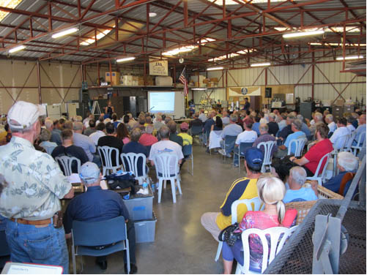
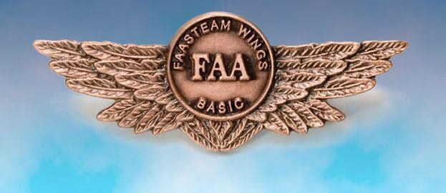
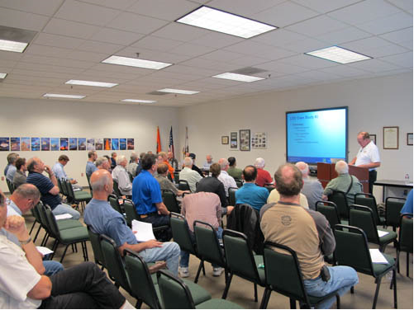
Thank you for attending
You are vital members of our GA safety community
Notes:
Your presence here shows that you are vital members of our General Aviation Safety Community. The high standards you keep and the examples you set are a great credit to you and to GA.
Thank you for attending.
(Next Slide)

Slide 26
Topic of the Month October
Compliance Philosophy
<Audience>
<Presenter>
< >
Notes:
(The End)

