Slide 1
US Commercial Space Launch Competitiveness Act
Dr. Sarah J. Nilsson, Esq.
A³IR Conference
January 2016

Slide 2
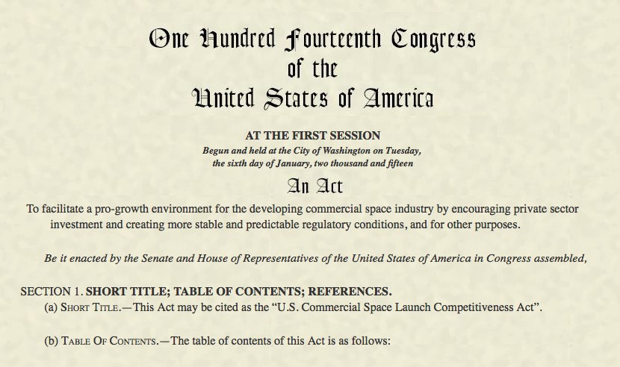

Slide 3
House Resolution (H.R.) 2262
Passed the House of Representatives-May 21, 2015
Passed Senate-November 11, 2015
Finally it becomes law-November 25, 2015
PL114-90

Slide 4
PL 114-90
An Act to facilitate a pro-growth environment for the developing commercial space industry by encouraging private sector investment and creating more stable and predictable regulatory conditions, and for other purposes.

Slide 5
Background
51 United States Code (U.S.C.) Subtitle V, Chapter 509 authorizes the Secretary of Transportation and, through delegations, the Federal Aviation Administration (FAA) Associate Administrator for Commercial Space Transportation, to oversee, license, and regulate both launches and reentries, and the operation of launch and reentry sites when carried out by U.S. citizens of within the U.S.

Slide 6
Background
51 United States Code (U.S.C.) Subtitle V, Chapter 509 is formerly the
Commercial Space Launch Act of 1984, as amended

Slide 7
Background
Chapter 509 directs the FAA to exercise this responsibility consistent with public health and safety, safety of property, and the national security and foreign policy interests of the U.S., and to encourage, facilitate, and promote commercial space launch and reentry by the private sector.

Slide 8
Background
The Office of Commercial Space Transportation (AST) was established in 1984 as part of the Office of the Secretary of Transportation within the Department of Transportation (DOT).
In November 1995, AST was transferred to the FAA as their only space-related line of business.

Slide 10
Background
On May 21, 1958, Senator A. S. "Mike" Monroney (D-OK) introduced a bill to create an independent Federal Aviation Agency to provide for the safe and efficient use of national airspace. Two months later, on August 23, 1958, the President signed the Federal Aviation Act, which transferred the Civil Aeronautics Authority's functions to a new independent Federal Aviation Agency responsible for civil aviation safety.

Slide 11
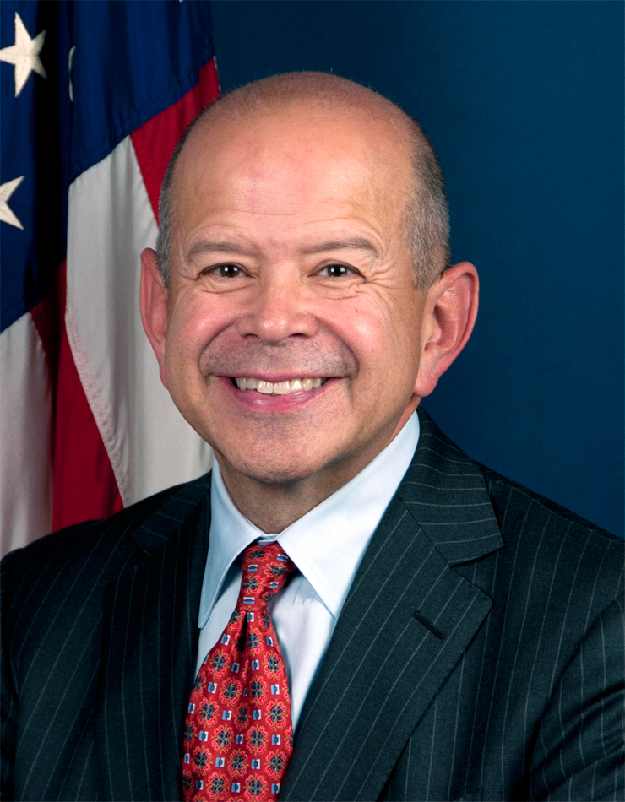
Background
“Our continuing mission is to provide the safest, most efficient aerospace system in the world.”
Michael Huerta, Administrator

Slide 12
Background
The Commercial Space Launch Amendments Act (CSLAA) of 2004 assigned the FAA the responsibility for regulating commercial human space flight.
In December 2006, the FAA issued human space flight regulations in accordance with its authority to protect public health and safety.

Slide 13
Background
The CSLAA prohibits the FAA from proposing regulations governing the design or operation of a launch vehicle to protect the health and safety of crew and space flight participants until October 2015, or until a design feature or operating practice has resulted in a serious or fatal injury, or contributed to an event that posed a high risk of causing a death or serious injury, to crew or space flight participants during a licensed or permitted commercial human space flight.

Slide 14
Background
Until such time, the CSLAA only requires that a space flight participant be informed of the risks of taking a ride on a rocket.
The FAA may also issue regulations setting reasonable requirements for space flight participants, including medical and training requirements.

Slide 15
Background
The CSLAA mandates that any regulations governing the design or operation of a launch vehicle to protect the health and safety of crew and space flight participants must take into consideration the evolving standards of safety in the commercial space flight industry.

Slide 16
Background
Limits in Regulatory Authority
The U.S Congress has only incrementally expanded DOT/FAA authority over commercial space transportation
1984 – included launch authority
1998 – added reentry authority
2004 – added firm authority over commercial human space flight

Slide 17
Background
Limits in Regulatory Authority
U.S. law contains limitations on FAA authority
The FAA can only regulate to the extent necessary
The FAA does not certify space launch vehicles –
it licenses the launch operation
Mission success is the responsibility of the commercial launch operator

Slide 18
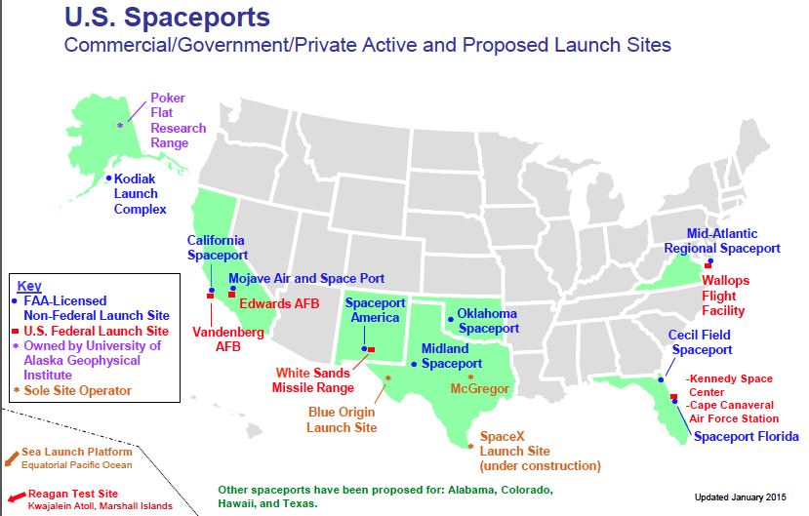

Slide 19
Background is over
Now for the
US Commercial Space Launch
Competitiveness Act

Slide 20
US Commercial Space Launch Competitiveness Act
Title I – Spurring Private Aerospace Competitiveness and Entrepreneurship
Title II – Commercial Remote Sensing
Title III – Office of Space Commerce
Title IV – Space Resource Exploration and Utilization

Slide 21
Title I Spurring Private Aerospace Competitiveness and Entrepreneurship - Space Act of 2015
United States Code
Title 51 – National and Commercial Space Programs
Chapter 509 – Commercial Space Launch Activities

Slide 22
Section 102 – International Launch Competitiveness
It is the sense of Congress that it is in the public interest to update the methodology used to calculate the maximum probable loss from claims arising under 51 USC § 50913

Slide 23
Section 103 – Indemnification for Space Flight Participants
Add: Space Flight Participants

Slide 24
Section 104 – Launch License Flexibility
New language: Reusable Launch Vehicles that will be launched into a suborbital trajectory
and Suborbital Rocket

Slide 25
Section 106 – Federal Jurisdiction
50914 (Liability Insurance and Financial Responsibility Requirements)
Adding new language
Any claim by a third party or space flight participant for death, bodily injury, or property damage or loss resulting from an activity carried out under the license shall be the exclusive jurisdiction of the Federal courts.

Slide 26
Section 107 – Cross Waivers
Adding new language
Launch or reentry license issued or transferred under this chapter shall contain a provision requiring the licensee or transferee to make a reciprocal waiver of claims with applicable parties (contractors, subcontractors, space flight participants, etc.)

Slide 27
Section 108 – Space Authority
Not later than 120 days after enactment
Director of Office of Science and technology Policy + Secretary of State + Secretary of Transportation + Administrator of NASA etc.
Assess non-governmental activities in space
Identify appropriate authorization/supervision
Recommend safety approach to minimize burdens to industry
Exception: ISS activities per NASA Act of 2010

Slide 28
Section 109 – Orbital Traffic Management
It is the sense of Congress that an improved framework may be necessary for space traffic management of US government assets and US private sector assets in outer space and orbital debris mitigation

Slide 29
Section 110 – Space Surveillance and Situational Awareness Data
Not later than 120 days after enactment
Study of feasibility of processing and releasing safety-related space situational awareness data and information to any entity consistent with national security interests and public safety obligations of the US

Slide 30
Section 111 – Consensus Standards and Extension of certain Safety Regulation Requirements
Amends 50905
Facilitation of Standards
Communication and Transparency
Interim Voluntary Industry Consensus Standards
Report not later than 270 days from enactment

Slide 31
Section 112 – Government Astronauts
Amends 50901
NASA needs to fly government astronauts within commercial launch vehicles and reentry vehicles – Commercial Crew Development Program

Slide 32
Section 113 – Streamline Commercial Space Launch Activities
It is the sense of Congress that eliminating duplicative requirements and approvals for commercial launch and reentry operations will promote and encourage the development of the commercial space sector

Slide 33
Section 114 – Operation and Utilization of the ISS
Maximum utilization of partnerships, scientific research, commercial applications, and exploration test bed capabilities of the ISS
Continuation through 2020 at least 2024

Slide 34
Section 115 – State Commercial Launch Facilities
It is the sense of Congress that state involvement, development, ownership, and operation of launch facilities can enable growth of Nation’s commercial suborbital and orbital space endeavors

Slide 35
Section 116 – Space Support Vehicles Study
Report not later than 1 year after enactment
Extent to which launch providers rely on services
Statutory, regulatory, and market barriers to use
Recommendations for legislative and regulatory action to ensure reduced barriers to use

Slide 36
Section 117 – Space Launch System Update
Space Shuttle now Space Launch System

Slide 37
Title II Commercial Remote Sensing
United States Code
Title 51 – National and Commercial Space Programs
Chapter 601 – Land Remote Sensing Policy
Section 201 - Annual Reports
Section 202 – Statutory Update Report

Slide 38
Title III Office of Space Commerce
United States Code
Title 51 – National and Commercial Space Programs
Chapter 507 – Office of Space Commercialization
Section 301 – renaming Commercialization to Commerce
Section 302 – Functions of Office of Space Commerce

Slide 39
Section 302 – Functions of Office of Space Commerce
Foster conditions for economic growth and technological advancement of US space commerce industry
Coordinate space commerce policy issues and actions within Department of Commerce
Represent Department of Commerce in development of US policies and in negotiations with foreign countries
Promote advancement of US geospatial technologies
Provide support to US government organizations working on Space-based positioning navigation

Slide 40
Title IV Space Resource Exploration and Utilization
United States Code
Title 51 – National and Commercial Space Programs
Chapter 513 – Securities of the States and Private Entities

Slide 41
New Definitions
Asteroid resource - space resource found on or within a single asteroid
Space resource – an abiotic resource in situ (in its original place) in outer space – includes water and minerals

Slide 42
New Addition
A US citizen engaged in commercial recovery of an asteroid resource or a space resource under this chapter shall be entitled to any asteroid resource or space resource obtained, including to possess, own, transport, use, and sell the asteroid resource or space resource obtained in accordance with applicable law, including the international obligations of the US

Slide 43
disclaimer
It is the sense of Congress that by enactment of this Act, the US does not thereby assert sovereignty or sovereign or exclusive rights or jurisdiction over, or the ownership of, any celestial body
(referring to Outer Space Treaty of 1967)

