Slide 1
AIRLINE LABOR LAW
BY: MITCHELL A. VASIN, ESQ.

Slide 2
ABOUT YOUR PRESENTER
AVIATION EXPERIENCE
Started taking flying lessons in high school (1990)
BS Aeronautical Science 1996 ERAU Prescott
Airline Transport Pilot, type rated in ATR42/72, B737, A320 series
18 years in the airline industry, 12 years at America West / US Airways / American Airlines
Over 12,000 hours of flight time
LABOR UNION EXPERIENCE
Over 15 years experience
Union officer
Contract enforcement (grievance / arbitration)
Legal campaign organizer & participant
LEGAL EXPERIENCE
Juris Doctor 2013 Arizona Summit Law School
Arizona Supreme Court extern
Fisher & Phillips LLP (national labor and employment law firm)
Vasin & Rocco PLLC: civil dispute, family law, and estate planning practice for aviation and airline employees

Slide 3
PRESENTATION OVERVIEW
WHAT IS A LABOR UNION?
What is their purpose? Why are they desirable?
THE RAILWAY LABOR ACT
Why was the RLA passed? What is its purpose?
LABOR UNIONS UNDER THE RLA
The laws affecting union membership.
AIRLINE MERGERS
How organized labor is affected?

Slide 4
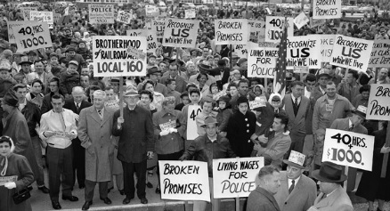
WHAT IS A LABOR UNION?

Slide 5
WHAT IS A LABOR UNION?
A NON-UNION AIRLINE

Slide 6
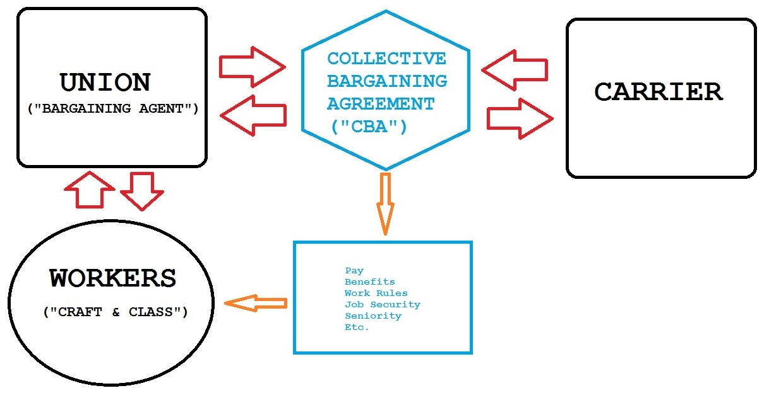
WHAT IS A LABOR UNION?
A UNIONIZED AIRLINE

Slide 7
WHAT IS A LABOR UNION?
THE THREE PRIMARY TENETS OF A LABOR UNION:
The group versus the individual
The exclusive representative
Democratic governance

Slide 8
WHAT IS A LABOR UNION?
IMPORTANT LABOR & EMPLOYMENT LAW CONCEPTS
At-will employment / just cause
Closed shop / Agency shop
Right-to-work

Slide 9
THE RAILWAY LABOR ACT

Slide 10
THE RAILWAY LABOR ACT
www.nmb.gov

Slide 11
THE RAILWAY LABOR ACT
A century ago, the railroads were the country’s lifeblood.
The state of employment law at the time resulted in numerous disruptions to railroad service.
Subject to varying state laws
Carriers regularly interfered with union organizing
Expiring contracts
No streamlined dispute resolution
Congress, with support of both airline labor and management, responded by passing a comprehensive set of statutes designed to promote labor peace and minimize disruption of rail service.

Slide 12
THE RAILWAY LABOR ACT
GENERAL PURPOSES OF THE R.L.A.
Prevent interruptions to carrier service;
Contracts do not expire
No strikes or lockouts unless NMB authorizes otherwise
Freedom to form and join unions;
Carriers cannot interfere with union affairs
NMB designates the unions
Prompt and orderly settlement of contract negotiations;
NMB - mediation services
Limitations on right to strike
Prompt and orderly settlement of contract disputes.
Federal courts generally do not have jurisdiction over labor disputes

Slide 13
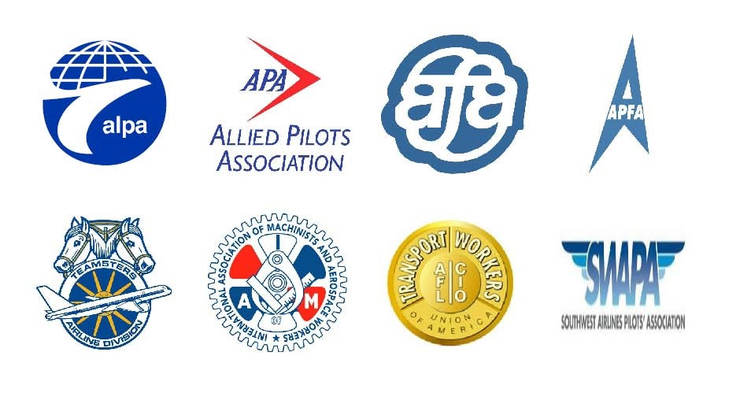
LABOR UNIONS UNDER THE RLA

Slide 14
LABOR UNIONS UNDER THE RLA
YOUR RELATIONSHIP WITH THE EMPLOYER:
RAILWAY LABOR ACT: 45 U.S.C. §§ 151 et seq. (1926)
Establishes the collective bargaining framework for railroads and airlines
Protects individual right to organize, join, and participate
YOUR RELATIONSHIP WITH THE UNION:
RAILWAY LABOR ACT: 45 U.S.C. §§ 151 et seq. (1926)
Duty of Fair Representation
LANDRUM-GRIFFIN ACT: 29 U.S.C. §§ 401-431 (1959)
Protects union participation, elections, and financial management
CIVIL RIGHTS ACT TITLE VII: 42 U.S.C. 2000e-2(c) et seq. (1964)
Prevents discrimination based upon race, color, national origin, etc.
UNION CONSTITUTION: common law
Governs the union’s internal governance

Slide 15
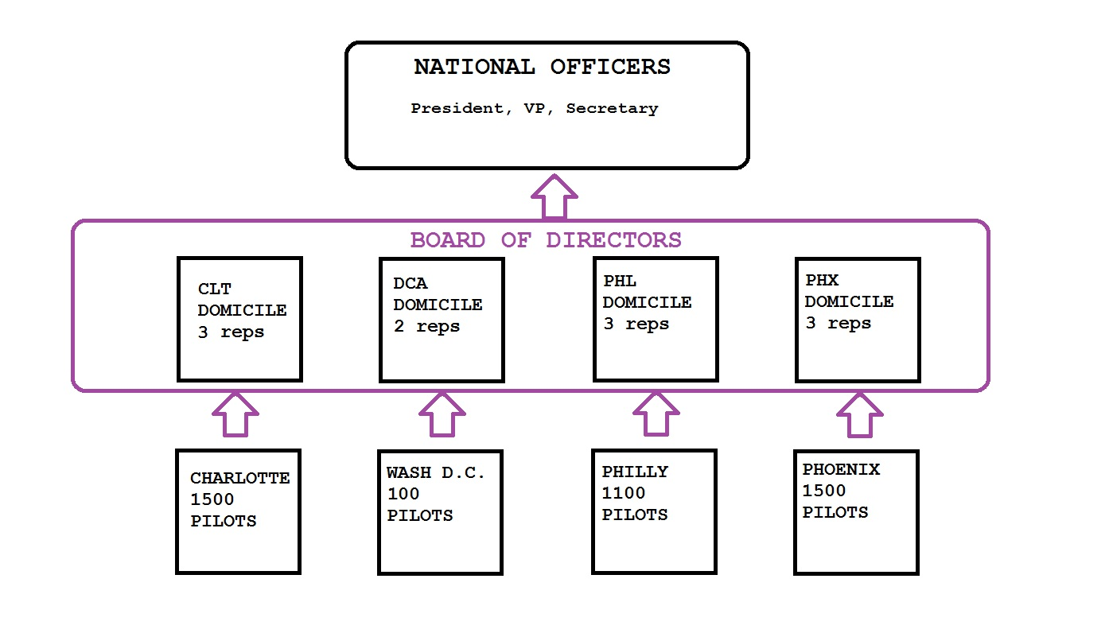
LABOR UNIONS UNDER THE RLA
UNION POLITICAL STRUCTURE

Slide 16
LABOR UNIONS UNDER THE RLA
 | UNION MEMBER | NONMEMBER
FINANCIAL OBLIGATION | YES (Dues and assessments per union constitution) | YES (Agency fee / germane expenses)
SUBJECT TO COLLECTIVE BARGAINING AGREEMENT | YES | YES
SUBJECT TO UNION CONSTITUTION | YES | NO
PROTECTED BY DUTY OF FAIR REPRESENTATION | YES | YES
RIGHT TO VOTE FOR REPRESENTATIVES & CONTRACT | YES | NO
RIGHT TO VOTE FOR A NEW UNION | YES | YES

Slide 17
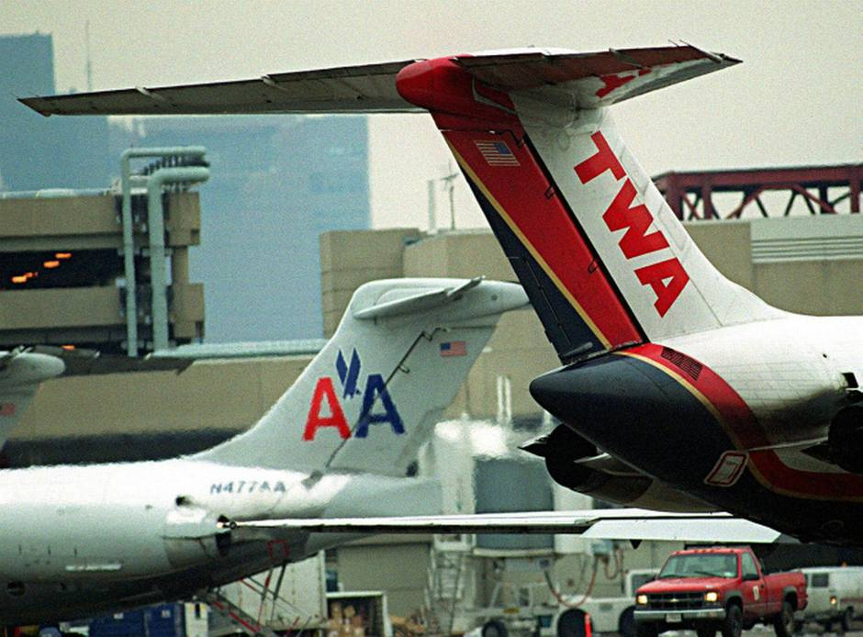
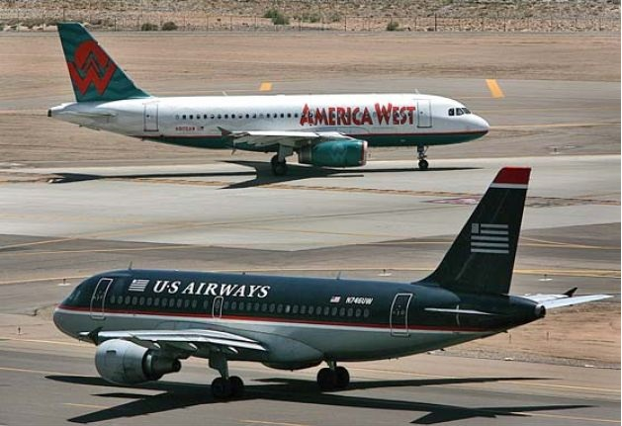
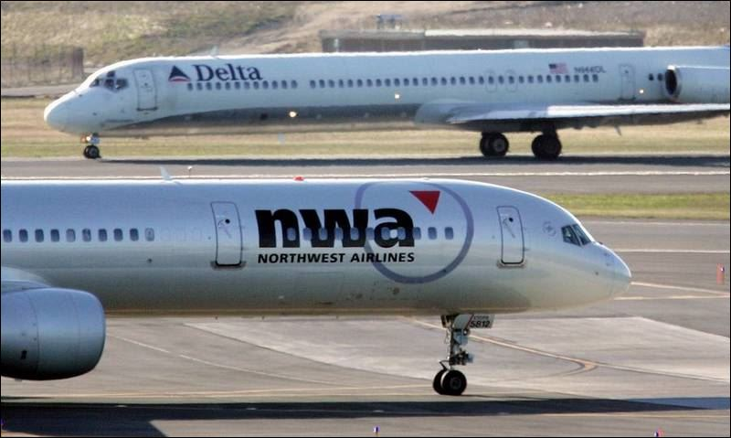
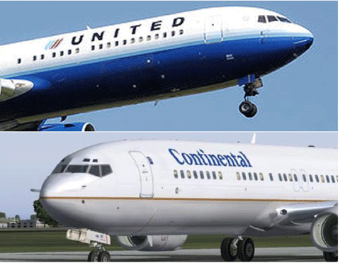
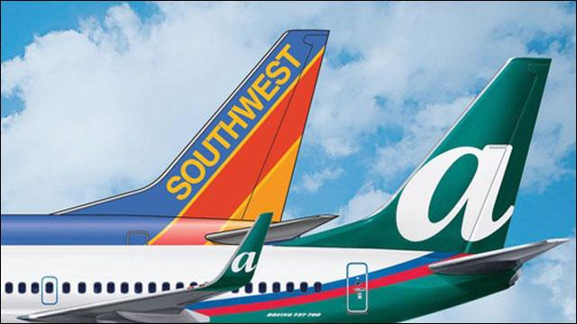
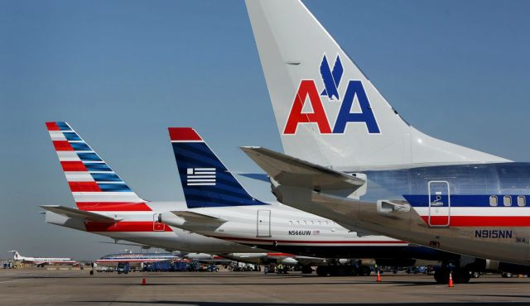
AIRLINE MERGERS

Slide 18
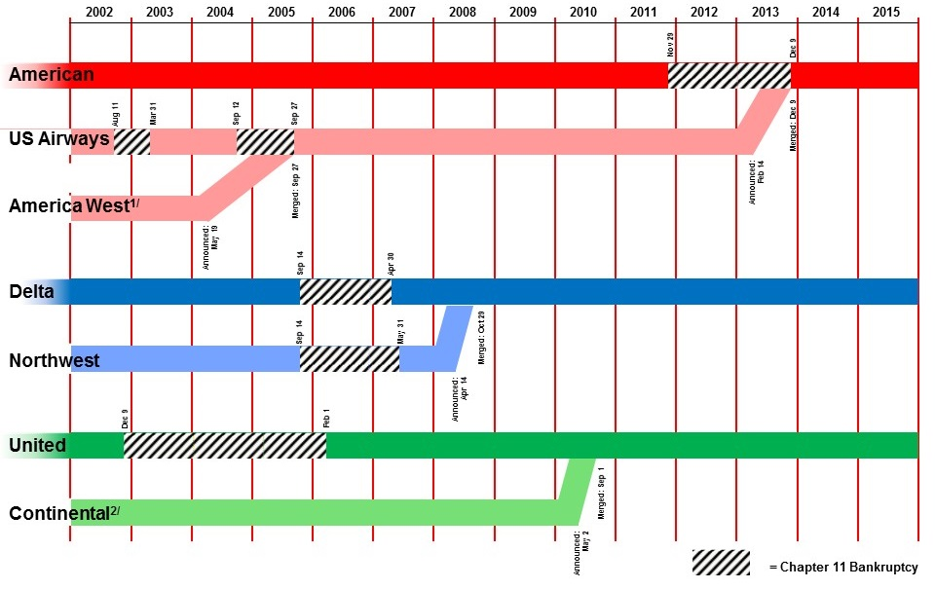
AIRLINE MERGERS

Slide 19
AIRLINE MERGERS
HOW MERGERS AFFECT ORGANIZED LABOR
Transition to a single union
Railway Labor Act: Single Carrier / election by NMB
Transition to a single collective bargaining agreement
Railway Labor Act: collective bargaining process
Sometimes: US Bankruptcy Code: rejection of collective bargaining agreements 11 U.S.C. 1113 (1984)
Integrate seniority lists
McCaskill-Bond statute: 49 U.S.C. 42112 (2007)
OFTEN VERY CONTENTIOUS!!!!!

Slide 20
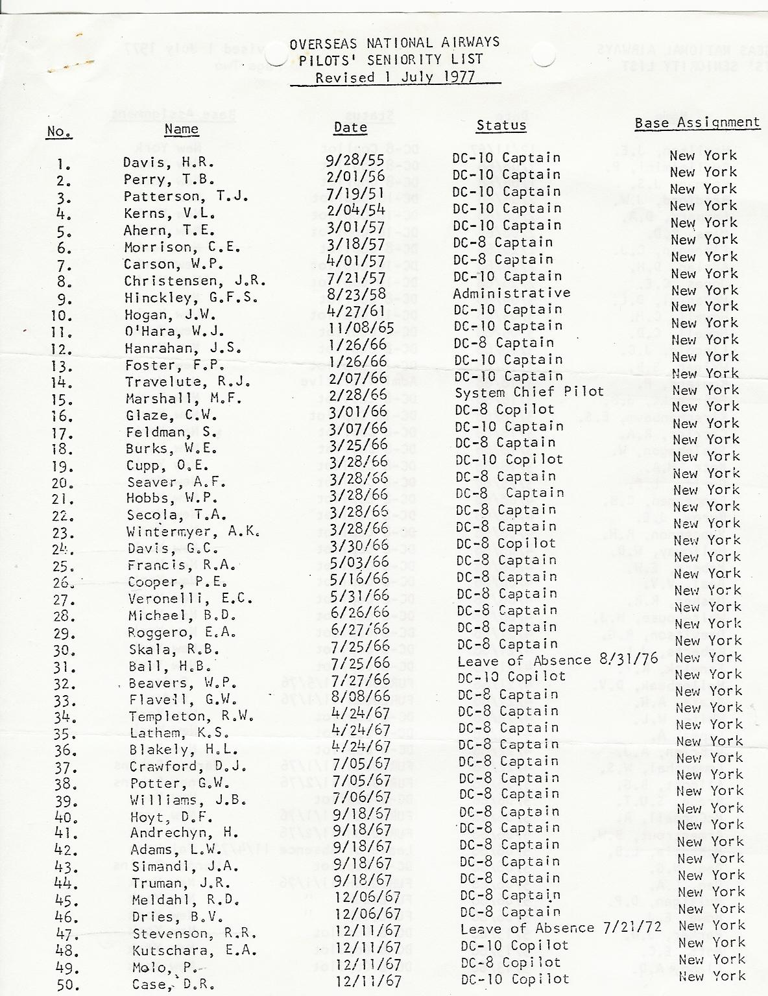
AIRLINE MERGERS
THE SENIORITY SYSTEM
Seniority is a CBA provision, generally governing:
Advancement / furlough
Monthly schedules
Annual vacation dates
Standby travel priority
Other provisions

Slide 21
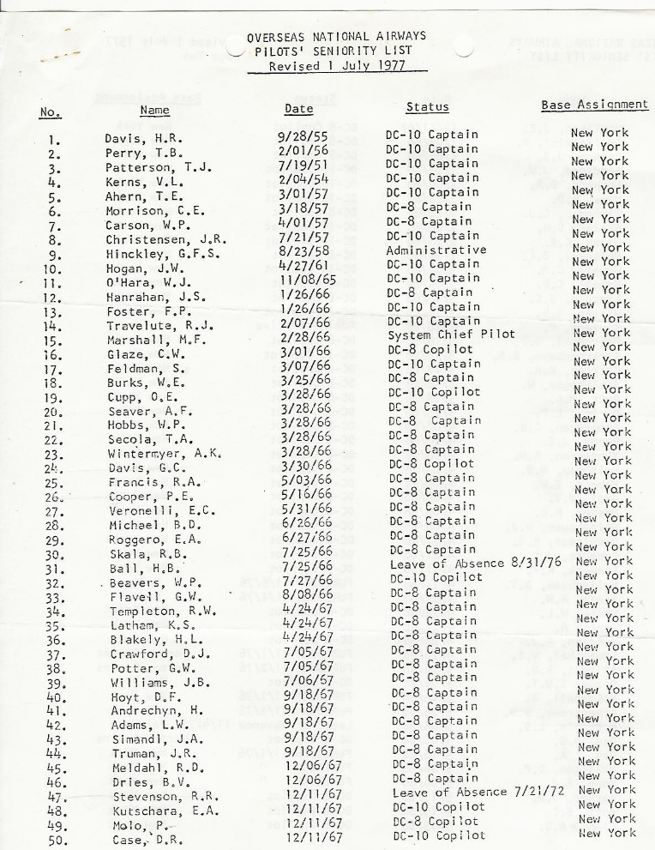
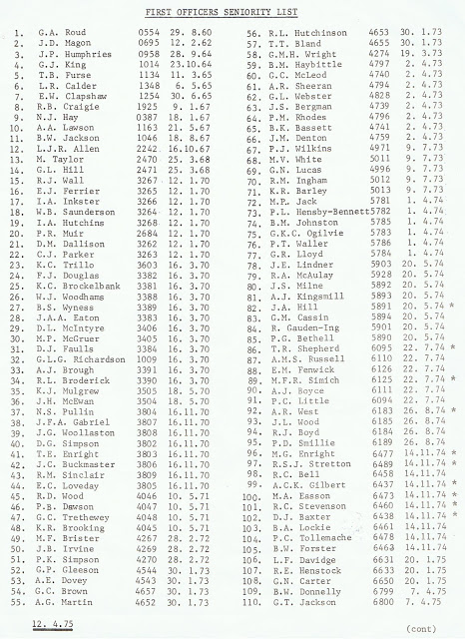
AIRLINE MERGERS
SENIORITY INTEGRATION

Slide 22
AIRLINE MERGERS
HISTORY OF SENIORITY INTEGRATION
Civil Aeronautics Board (1938)
Developed and required a seniority integration process, known as Allegheny-Mohawk LPPs §§ 3, 13
Deregulation (1978)
Seniority integration fell back into the collective bargaining process under the Railway Labor Act – a “free for all”
McCaskill-Bond statute (2007)
In response to American Airlines’ acquisition of TWA; too many lopsided integrations

Slide 23
AIRLINE MERGERS
AMERICAN AIRLINES / US AIRWAYS PILOT SENIORITY INTEGRATION
To be decided by a panel of 3 arbitrators.
19 days of hearings held in September & October 2015, January 2016, which generated 5000+ pages of hearings transcripts, hundreds of exhibits, and several million dollars in attorneys fees.
Arbitration Award expected June / July 2016.
No matter the result, several lawsuits are expected to be filed (and already have been filed), all with the purpose of challenging the result of the process.

Slide 24
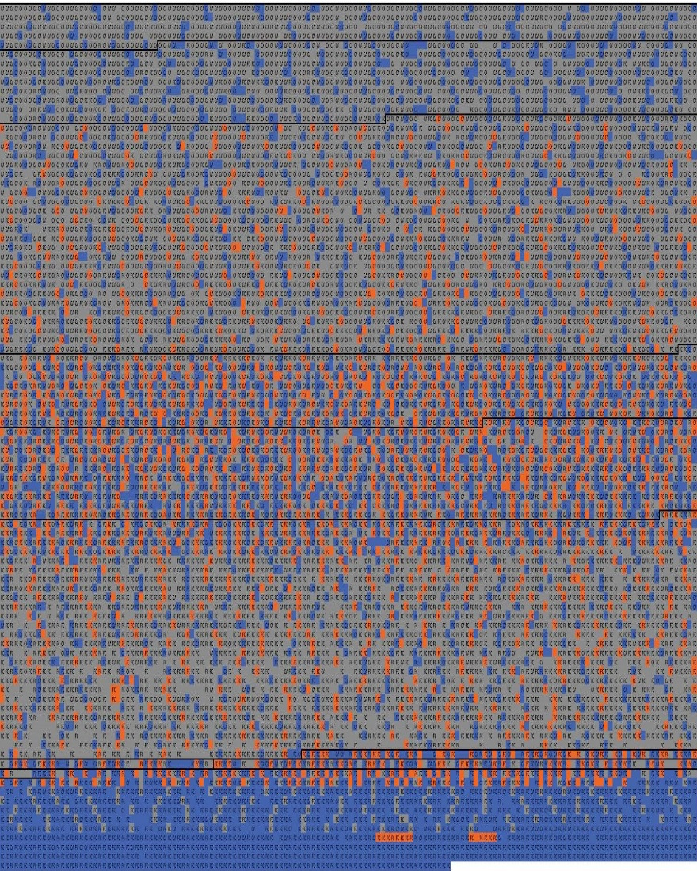
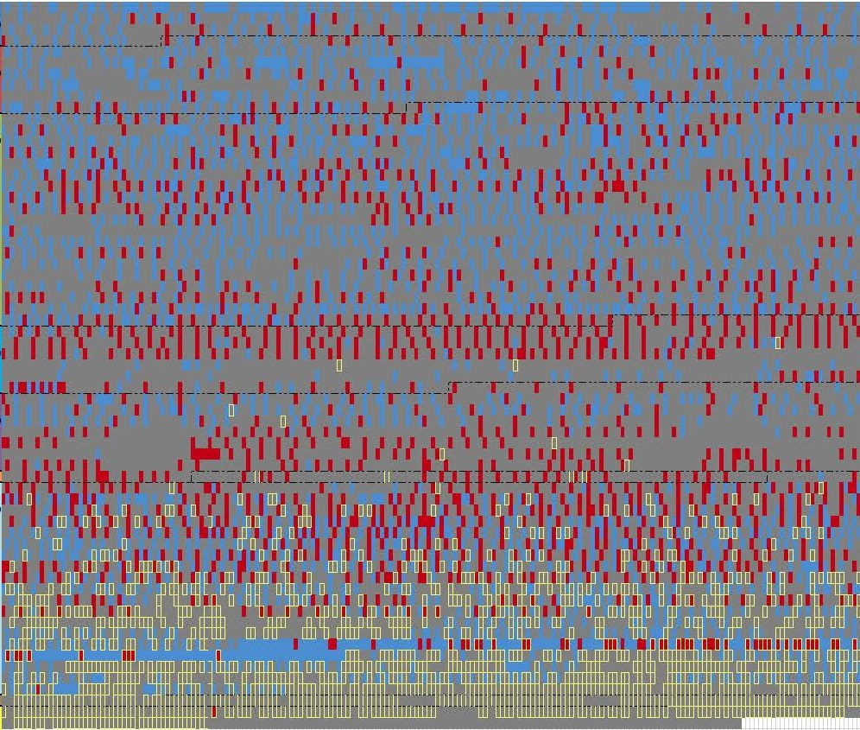
AIRLINE MERGERS

Slide 25
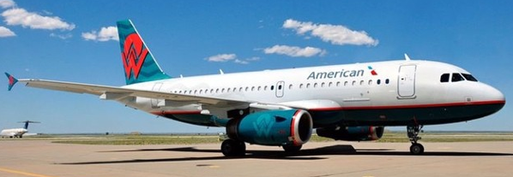
QUESTIONS????
Please feel free to call or email:
Mitch Vasin
Cell (602) 318-2614
mitchvasin@gmail.com
Two career secrets that they may not teach you at ERAU:
Networking & relationships are vital to your career.
Don’t be afraid to reach out: people love to talk about themselves!

