Slide 1
Estate and Life Care Planning
Dr. Sarah J. Nilsson, Esq.

Slide 3
Advance Directives
Office of the Attorney General of Arizona

Slide 4
Advance Directives
Living will
Medical power of attorney
Mental health power of attorney
All states have laws that allow us to make future health care treatment decisions now so that if we become incapacitated and unable to make these decisions later, our family and doctors will know what medical care we want or do not want. State laws also allow us to appoint a representative to make future health care treatment decisions for us if we become incapacitated, since we cannot predict what future decisions might be necessary. These laws are called "advance directives" or "health care directives."
https://www.azag.gov/sites/default/files/sites/all/docs/lifecare/Life-Care-Planning-Packet-Complete.pdf

Slide 5
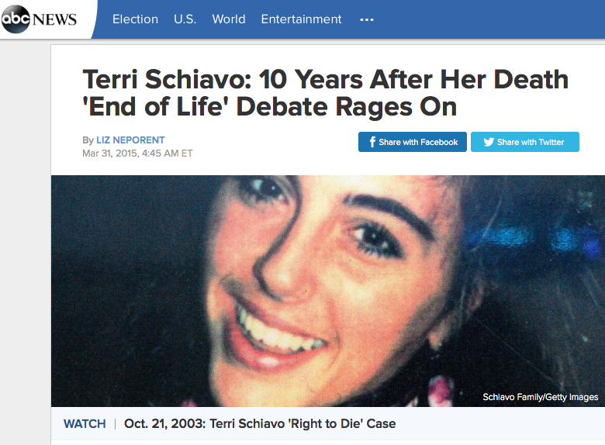

Slide 6
The Law
Our constitutional rights to privacy and liberty include the right to make our own medical treatment decisions. The government also has interests in some of our medical treatment decisions, which include preserving life, safeguarding the integrity of the medical profession, preventing suicide, and protecting innocent third parties (Arizona, for example, does not approve or authorize suicide or assisted suicide).
If someone becomes unable to understand, reason or make judgments, his/her constitutional rights to make medical treatment decisions remain. A health care representative appointed by the person in writing or, if no one has been appointed, a representative appointed according to the law, will make treatment decisions as follows:
Following expressed wishes
Using substitute judgment
Using good faith to decide best interests

Slide 7
Medical Choices
Comfort care
Under Arizona law, comfort care is an effort to protect or enhance quality of life without artificially prolonging life.
Comfort care often means pain medication, e.g. morphine.
Comfort care can also include oxygen and perhaps stopping certain medical interventions.
It may involve offering but not forcing food or fluids, keeping the patient clean, cooling or warming the patient, humidifying the room, turning lights on or off, holding the patient's hand, and comforting him/her with soothing words and music.

Slide 8
Medical Choices
Cardiopulmonary Resuscitation (CPR) and Artificial Breathing
CPR was developed to assist victims facing sudden death, such as a heart attack or trauma, and increases the likelihood of long-term survival.
Unless a doctor or other licensed health care provider authorizes a DO NOT RESUSCITATE (DNR) or you have a valid Prehospital Medical Care Directive, CPR is administered virtually every time a person’s heart stops.
Ventilators put air and therefore oxygen into the lungs, and thus can save lives. Oxygen is administered for a short term by a tube through the nose or mouth and for a longer term via a tracheotomy (hole in the throat).

Slide 9
Medical Choices
Artificially administered food and fluids
Food and fluids can be artificially administered by medical procedures, including intravenous treatment or by various types of tubes inserted into the body (if food and fluid can be taken by spoon, drink, or other natural means, it is not artificially administered.

Slide 10
Talk with Others
Your health care representative
Your spouse, children, other relatives, close friends
Your doctor, clergyperson, others

Slide 11
Consider and Discuss
Quality of life and prolonging life
Life support
Organ donation
Autopsy
Comfort care and other support when you are dying
Remembrances to loved ones, and funeral or other arrangements

Slide 12
The Documents
When completed, the documents may be:
Kept in a safe place that is also readily accessible (the originals)
Given to your representative(s) and your doctor(s) (the copies)
Also given to family and close friends (the copies)
Taken to hospital or other health care facility (the copies)
Registered with Arizona Advance Directive Registry at the Arizona Secretary of State (confidential database)
May be updated as you wish – the most recent form is the valid one

Slide 13
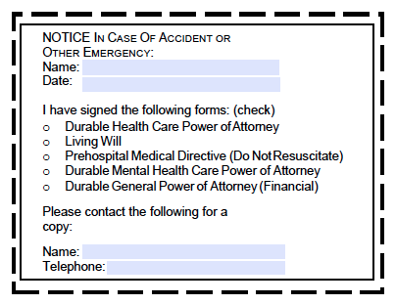
Wallet-sized Notice

Slide 14
Durable Health Care Power of Attorney
A document lets you choose another person, called an "agent," to make health care decisions if you can no longer make those decisions for yourself.
Unless the document includes specific limits, the agent will have broad authority to make any health care decision you could normally make for yourself. This could include a decision about whether or not to continue tube feeding.

Slide 15
Living Will
A written statement that expresses your wishes about medical treatment that would delay death from a terminal condition.
It also applies to situations of persistent vegetative state or irreversible coma.
A Living Will would speak for you in the event that you were unable to communicate. It gives direction and guidance to others, but is not as broadly applicable as a Durable Health Care Power of Attorney.

Slide 16
HIPAA
There is a difference of opinion as to whether HIPAA (Health Insurance Portability and Accountability Act of 1996) applies to life care planning documents, such as those provided here by the Attorney General's Office.
In an abundance of caution, we have placed a HIPAA release under the "Signature and Verification" section of both the Health Care and Mental Health Power of Attorney forms, just above the space for your signature. This release should reassure anyone concerned about HIPAA issues, especially medical personnel, that they may provide information about your care to your representative(s).

Slide 17
General Power of Attorney
Use this if you want the other person to be able to act on your behalf in a wide variety of situations.
Use to give another adult complete authority to act on your behalf in most situations, including personal finances, real and personal property, and a large range of business transactions.
DO NOT USE the General Power of Attorney form to give another adult authority to make decisions regarding your health.
http://www.superiorcourt.maricopa.gov/superiorcourt/self-servicecenter/forms/powerofattorney/gn_poa1.asp

Slide 18
Special Power of Attorney
Use this if you want the other person to be able to act on your behalf in specific instances only.
Use this to give another adult authority to act on your behalf in such situations like a one-time business transaction or a specific sale of real or personal property.
http://www.superiorcourt.maricopa.gov/superiorcourt/self-servicecenter/forms/powerofattorney/gn_spoa1.asp

Slide 19
Durable Power of Attorney
The GENERAL and SPECIFIC powers of attorney can all be made “durable” by adding certain text to the document.
This means that the document will remain in effect or take effect if you become disabled or incapacitated.

Slide 20
Parental Power of Attorney
Use this if you want to give the other person temporary authority over your child(ren).
This form begins on a specific date and ends not more than six months later.
The only exception to the six month period is for active military personnel, who are given one year delegation of parental authority.
DO NOT USE the Parental Power of Attorney form to give another adult guardianship or custody of your child.
http://www.superiorcourt.maricopa.gov/superiorcourt/self-servicecenter/forms/powerofattorney/gn_ppoa1.asp

Slide 21
Some Terms
Principal: person who gives the authority to carry out his or her business.
Attorney in Fact: person or agent chosen by the principal, who accepts the responsibility. (DO NOT CONFUSE with attorney at law, a lawyer).

Slide 22
Will
A will is a written document that directs the disposition of a person's property after his or her death.
A will nominates one or more "personal representatives," sometimes also referred to as "executors," to manage and distribute the estate.
A will can also nominate a person to serve as a guardian and/or a conservator for a minor child or incapacitated adult.

Slide 23
What happens if a person dies without leaving a will?
Any assets in his or her estate will be distributed according to Arizona laws that designate which family members, or "heirs," will receive assets.

Slide 24
Does a will affect all assets?
Assets for which you have set up a different method of transfer, such as beneficiary designations, payable on death (POD) accounts, transfer on death (TOD) accounts, joint tenancy with right of survivorship, community property with right of survivorship, and/or titled into the name of a Trustee, are NOT affected by a will.
Remember to check whom you have named as beneficiary on any IRAs, annuities, life insurance and/or retirement plans.
You can also name a beneficiary for your car, and record a beneficiary deed for real property. Assets with these kinds of transfer mechanisms automatically pass to the surviving owners or named beneficiaries.

Slide 25
Can a will be changed?
A will can be changed or revoked anytime before death. Often simple changes are made by an amendment called a "codicil."

Slide 26
Probate
Probate is the process of submitting a deceased individual's will to the court, appointing a personal representative and following through with the legal requirements to dispose of the person's assets.
Probate proceedings are governed by the law of the state where the deceased person maintained his or her legal residence at the time of death, and by the probate laws of any other state where real property was located at the time of death.

Slide 27
Does a person need a large estate to have a will?
No.
Any person wishing to designate who will receive their assets at death should have a will.
Individuals with minor children will want a will to nominate a guardian and to manage the assets for the minor children in a trust (which may be created under the will) and/or a custodial account.

Slide 28
Who should draft a will?
Ideally a lawyer should draft a will. Only an expert legal professional can advise the best alternatives with respect to an individual's estate plan.

Slide 29
Holographic Will
A holographic will is hand-written by the person making the will and needs to be signed by that person.
Although a date is not required, it is recommended so that the last will of that person can be determined.

