Slide 1

If You’re Getting Paid to Fly People or Cargo – Here’s How to Make Sure it’s Not an Illegal Charter!
Notes:
Lots of people ask us about the black over the eyes in this pic. It’s represents the clueless, careless and criminal.
Clueless- Those that don’t know or understand rules or safety consequences…especially the customers/pax
Careless- Those who don’t understand they are breaking the rules…
Criminal- Those who spend more time and energy doing it wrong than they would operating correctly…also doing it intentionally wrong
Motive to the illegal operator is of course a competitive advantage and money. Motive to the “Passenger(s)” is, of course, saving money…buying cheap air transportation! Safety Attributes are not present!! (and neither is there protection for the Certificate Holders that are trying to comply with the regulations, but are getting ‘under-bid’ by the illegal operators!)
(Next Slide)
2020/08-24-40 (E) PP

Slide 2
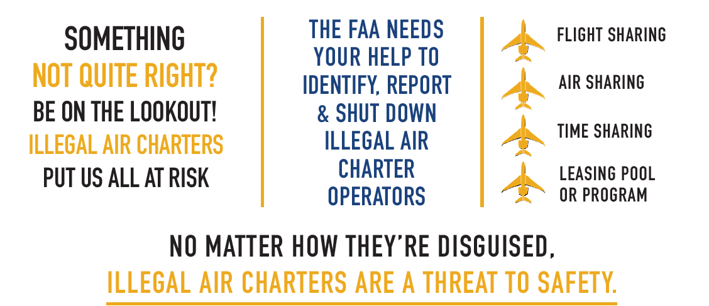
Notes:
Illegal charters are present, that is a fact….they can go by many names that sound official or technical. Another complication is they may go by a legal name or imply a legal operation but in day to day operations they are not operated with the same safety standards or over sight as legitimate operators. It’s crucial for you, the end user, to understand what to look for, questions to ask and for you to be wary of the “it’s too good to be true deal”. Safety is the priority and these operations do not adhere to the required safety rules of the legal operators, therefore they are a safety risk to you and the National Airspace System.
(Next Slide)

Slide 3
Notes:
It’s all about Safety…..although its hard to tell…. this was a Cessna Citation 500….this crash occurred near Oklahoma City back in 2008….the operation of this aircraft was a mess, it was managed by one company, leased out an operated by another, a 135 certificate holder that was only authorized to fly helicopters, and the passengers in the back thought they were on a legitimate charter.
It’s really no secret that right now…that Congress, FAA, NATA and our others in the industry, have turned the spotlight on high regarding illegal charters and leases.
Understanding what an illegal charter is and the threat to Safety is why identifying and eliminating illegal charters is important.
Legislative Mandate
SEC. 540. Report on illegal charter flights.
Not later than 180 days after the date of enactment of this Act, the Secretary of Transportation shall submit to the appropriate committees of Congress an analysis of reports filed during the 10-year period preceding such date of enactment through the illegal charter hotline of the FAA and other sources that includes—
(1) what follow-up action the Department of Transportation or the Administration takes when a report of illegal charter operations is received;
(2) how the Department of Transportation or the Administration decides to allocate resources;
(3) challenges the Department of Transportation or the Administration face in identifying illegal operators; and
(4) recommendations for improving the efforts of the Department of Transportation or the Administration to combat illegal charter carrier operations.
(Next Slide)

Slide 4
Illegal Charters – The Why
Offset expensive costs of aircraft ownership
Avoids fees & taxes, e.g., FET
Avoids costly expense of FAA certification and continuing oversight
Competitive advantage over a legitimate operator
Hence to Make Money
Notes:
Federal Excise Tax…7.5%, without charging this, illegal operators have an immediate advantage over legitimate operators.
With CARES Act, FET is suspended temporarily.
(Next Slide)

Slide 5
Authorized Operators are…
Held to a higher level of FAA-approved pilot training and certification
Robust operational safety rules, including flight and duty time restrictions for pilots
Higher level of maintenance requirements
FAA performs more frequent checks on operator, crewmembers and aircraft
.
Notes:
Without the higher safety bar requirements and oversight, illegal operators pose a tangible safety threat to the flying public.
(Next Slide)

Slide 6
An Illegal Charter is..
Sham Dry Lease
  Most common today
  Operational control remains with lessor not lessee
  See AC 91.37B – Truth In Leasing
Legitimate 135 operators
  Operating aircraft not on their certificate
Aircraft owners
  To off-set cost of aircraft ownership
Notes:
Sham Dry Lease: Most common we see right now and can be simple and complex…at it’s basic level a lessor “dry” leases an aircraft to lessee….that lessee should assume operational control and the lessee would control all functions BUT in reality the scam is the lessor retains control and provides the lessee/customer everything.
Just want to put a plug in for AC 91.37b…it is actually a great document to understand the sham dry lease and help in spotting one.
Legitimate 135 Operators: Those certificated operators using aircraft not on their certificate
Aircraft Owners: Self-explanatory
(Next Slide)

Slide 7
An Illegal Charter is..
DEMO Flights
  What is being demonstrated exactly? Air transportation (not legal) or the aircraft for purchase (legal)
Aircraft Management Companies
  Operating illegal charters as a side business with owner’s aircraft
“FAKE” Flight Instruction
  Offered point to point in aircraft not typically used for initial training
Misuse of Expense Sharing
  Disguise for Air Transportation
  AC 61-142, 61.113(c)
Notes:
Demo flights: This excuse or scam is starting to become more noticeable. An illegal operator just disguises the air transportation as a “demo”. Cannot be a demo of air transportation services. Demo for purchase of the aircraft. NTSB Case law
A/C Mgmt. Companies: Operating illegal charters on the side. Sometimes owners know, and sometimes they don’t. Often leads to falsification of maintenance hours to hide hours on an aircraft, possible significant safety concerns.
FAKE Flight: Had a company offering flights from point a to point b – and by the way get some iPad instruction along the way. Clearly not for flight instruction, guise for air transportation
Misuse of Expense Sharing: – disguise for air transportation AC 61-142 Sharing Aircraft Operating Expenses IAW 61.113(c)
(Next Slide)

Slide 8
Recognizing Illegal Charters
AC 120-12A
Defines Common v. Private Carriage
Defines the four pillars of Common Carriage
AC 91-37B
Defines “Truth in Leasing”, helps determine Operational Control
Notes:
The two ‘over-arching’ ACs are 120-12 and 91-37. BOTH ACs are critically important to helping understand illegal charter…along with case law and legal interpretations on illegal charters and of course the FARs.
(Next Slide)

Slide 9
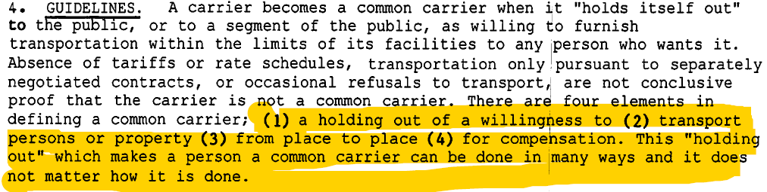
AC 120-12A Holding Out
Notes:
You may have to tailor your presentation to the audience. Holding out discussion to the general public will have to be simplified to what it looks like and an understanding if they found an operator thru holding out….that operator is a common carrier and needs a certificate to conduct operations. If you have potential operators (legal and not) you can go into more detail on holding out and being a common carrier. Holding out is widely misunderstood and therefore some people the careless and clueless may not know they are doing it
120-12A issued 4/26/1986 Although AC 120-12 was written in 1986, the over-all document is still supported by Legal interpretations and NTSB ALJ decisions. A search of “Holding Out” in Legal Interpretations gives 9 pages (89 Interpretations) of references! Holding Out is important in defining a Common Carrier. SOOOO how is “Holding Out” accomplished??
Lets talk about each element individually.
(Next Slide)

Slide 10
Element 1) A Holding Out of a Willingness
Signs and advertising
Actions of agents, agencies, sales people
Reputation, word of mouth
Willing to carry only certain kinds of traffic, or only one organization, if available to anyone
Notes:
This "holding out" which makes a person a Common Carrier can be done in many ways and it does not matter how.
Signs and advertising are the most direct means of "holding out“ but are not the only ones.
A "holding out" may be accomplished through the actions of agents, agencies, or salesmen who may, themselves , procure passenger traffic from the general public and collect them into groups to be carried by the operator. It is particularly important to determine if such agents or salesmen are in the business of selling transportation to the traveling public not only through the '*group*' approach but also by individual ticketing on known common carriers.
Physically holding out without advertising where a reputation to serve all is gained is sufficient to constitute an offer to carry all customers. There are many means by which physical holding out may take place. For example, the expression of willingness to all customers with whom contact is made that the operator can and will perform the requested service is sufficient. The fact that the holding out generates little success is of no consequence. The nature and character of the operation are the important issue.
A carrier holding itself out as generally willing to carry only certain kinds of traffic is, nevertheless, a common carrier. For instance, a carrier authorized or willing only to carry planeloads of passengers, cargo, or mail on a charter basis is a common carrier, if it so holds itself out. This is, in fact, the basic business of supplemental air carriers.
A carrier flying charters for only one organization may be a common carrier if membership in the organization and participation in the flights are, in effect, open to a significant segment of the public. Similarly, a carrier which flies planeload charters for a common carrier, carrying the latter's traffic, engages in common carriage itself.
(Next Slide)

Slide 11

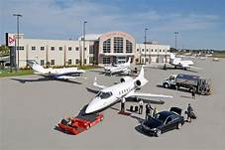
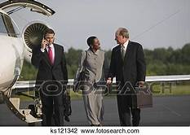

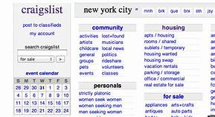



Public Availability Determined Under 5 USC 552.
Notes:
But – what and How does HOLDING OUT look like?
Traditionally, magazines, brochures, etc.
Websites – provide information on charter operations
Another traditional is postings on bulletin boards at FBO and Terminals
Another way of holding out is reputation and Word of Mouth – I tell Don, who tells Mike, and he tells Tim that Misty can provide a charter. Golf course conversation…
But we have moved into a new generation of holding out - Social Media and social media is typically FREE…
Online blogs
Facebook, Instagram
And then the Craigslist, Ebay, Pinterest
And the newest is using INFLUENCERS
Influencers in social media are people who have built a reputation for their knowledge and expertise on a specific topic. They make regular posts about that topic on their preferred social media channels and generate large followings of enthusiastic, engaged people who pay close attention to their views. For example, influencers posting with hastags #seejoescharterservice or recommending by blogging or commenting on their own sites or others
(Next Slide)

Slide 12

Element 2) Persons or Property
Notes:
Self explanatory
(Next Slide)

Slide 13
Element (4): For Compensation or Hire
Compensation is broadly defined by the FAA
  Money
  Good will
  Expectation of future business
  Nominal charges such as “free transportation by air” included in the passenger’s hotel fee.
Notes:
Occasionally, offers of free transportation have been made to the general public by hotels, casinos, etc. In such cases, nominal charges have been made which, according to the operators, bear the expense of gifts and gratuities. However, the operators maintain that the transportation is free. The courts have held that such operations are common carriage based on the fact that the passengers are drawn from the general public and the nominal charge constituted compensation.
Goodwill- I give you service for a return of favor or something of value
Future business- I’ll fly u for free but you funnel business/passengers/customers my way
(Next Slide)

Slide 14
Operational Control
Operational Control is: Initiate, Conduct, and Terminate a Flight – Most Everything!
AC 91-37B helps determine Operational Control and Legal Responsibility for the flight
AC 91-37B asks 7 questions to help determine…
  Who really has control – regardless of the wording of a contract or lease agreement.
  In other words, regardless of what the lease says,
  what is really happening?
Notes:
AC 91-37B (02/10/2016) states that Operational Control means the authority over initiating, conducting or terminating a flight involving Aircrew; Aircraft; and Flight Management (wx minimums; loading; CG; icing conditions; fuel requirements. 91-37 states that Monetary and Logistical issues associated with the aircrew and aircraft are a part of Operational Control.
In its basic form operational control is legal aircraft, legal crew and flight management. It’s a pillar of FAA safety and a key to safe operations.
There are lots of “SHAM” dry leases (“Sham” as stated in AC 91-37). AC 91-37 was written to educate the Lessee (so the Lessee understands that he/she has LEGAL responsibility)! Note: sometimes ‘lease’ agreements may be called Operating Agreements, Management Agreements, Lease Agreements, etc.
If a Lessee (Sham Dry Lease) doesn’t understand anything about Operational Control, that is a huge red flag! Even if understand they have to be excercsisng operational control.
Don’t pay much attention to the ‘title’…what does the ‘agreement’ say, and most importantly, what is actually happening!
(Next Slide)

Slide 15
Who Has Operational Control?
This is the Main Question
The answer will further define whether this is an Illegal Charter, or a legitimate Dry Lease.
  In a true Dry Lease, the Lessee knows they have Operational Control and know how to use it
When the Lessee’s answers to the “7” questions in AC 91-37B, are someone (entity) other than the Lessee is responsible or “I don’t know”, then the Lessee does not have Operational Control.
Notes:
The responses to the 7 questions in AC 91-37B will immediately shed light on ‘who’ really has Operational Control!
Also, ‘multiple’ dry-leases from one entity MAY be RED FLAG. Multiple aircraft on a dry lease is also a red flag.
(Next Slide)

Slide 16
Who Has Operational Control? The “7 Deadly Sins”
Who makes the decision to assign crewmembers and aircraft; accept flight requests; and initiate, conduct, and terminate flights?
For whom do the pilots work as direct employees or agents?
Who is maintaining the aircraft and where is it maintained?
Prior to departure, who ensures the flight, aircraft, and crew comply with regulations?
Public Availability Determined Under 5 USC 552.
Notes:
What are these questions in AC 91-37B
But Advisory Circular 91-37B, Truth and Leasing, provides the 7 Deadly Sins, and the answers to these questions will help establish who has operational control.
See Note 2 on page 5 of the AC. If the passenger doesn’t know what operational control is or they are not responsible for each action, or they have no idea what the question means, the lessor remains in control and it is an illegal charter.
(Next Slide)

Slide 17
Who Has Operational Control? The “7 Deadly Sins”
Who decides when/where maintenance is accomplished, and who directly pays for the maintenance?
Who determines weather/fuel requirements, and who directly pays for the fuel?
Who directly pays for the airport fees, parking/hangar costs, food service, and/or rental cars?
These are from the flying public, passenger point of view.
Public Availability Determined Under 5 USC 552.
Notes:
Continue with questions
These 7 questions are great and a good start but it is not all of the questions regarding operational control you can ask
(Next Slide)

Slide 18
So, What Can I Look For Or Ask to Avoid Illegal Charter?
Ask to see the operator’s air carrier or operating certificate.
Ask to see a list of specific aircraft authorized by the FAA for the operator to utilize. This document is called paragraph D85 of the Operations Specifications.
A legitimate charter operator will never require a “dry lease” to be signed for your trip.
Public Availability Determined Under 5 USC 552.
Notes:
Legitimate operators should give you these 2 documents without hesitation or complaint.
Legitimate charter operators have FAA authority to operate commercial charters, they are in operational control of those flights, they do not need nor will they require you as the end user to sign a dry lease….
(Next Slide)

Slide 19
So, What Can I Look For Or Ask to Avoid Illegal Charter?
•A lack of Federal Excise Tax charged to the consumer. Legitimate operators have to charge this. If the price is too good to be true, it probably is.
•Any evasiveness to questions or concerns. Legitimate operators should be transparent and helpful.
•If the pilot or someone associated with the company coaches passengers on what to say or do if an FAA aviation inspector meets the aircraft at its destination.
Public Availability Determined Under 5 USC 552.
Notes:
Other red flags
(Next Slide)

Slide 20
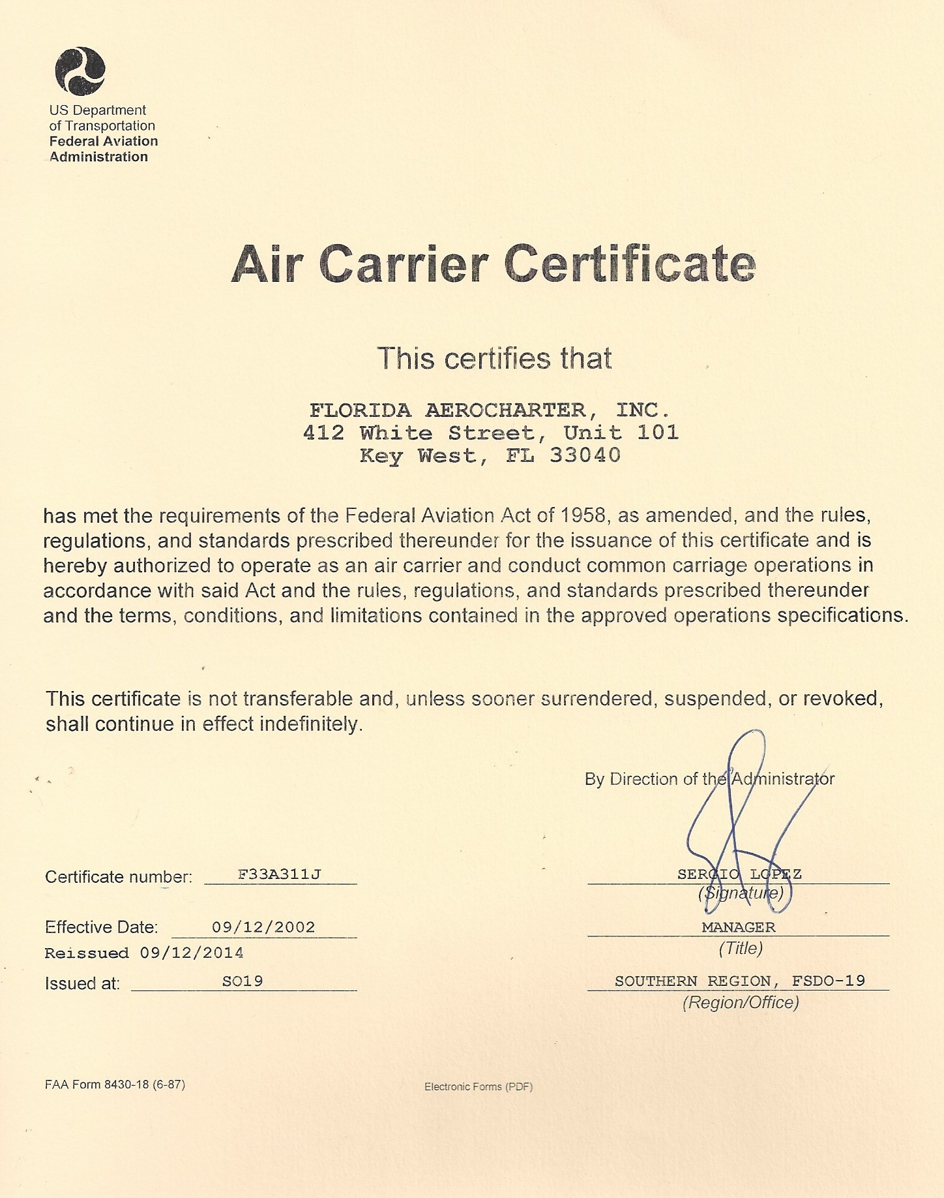
Public Availability Determined Under 5 USC 552.
Notes:
For the public, make sure the name matches who you think should be operating the flight, if it doesn't ask why? Explain it to me. Or, worse if the operator gives you some other document, you have a problem.
(Next Slide)

Slide 21
Public Availability Determined Under 5 USC 552.
Notes:
Aircraft tail numbers listed in paragraph D85, for a legitimate operator, these are the only ones they can utilize in commercial air transportation.
(Next Slide)

Slide 22
What are some resources available to me?
www.faa.gov/go/safeaircharter
National Air Transportation Association (NATA) website www.avoidillegalcharter.com
Local Flight Standards Office
Local FAASTeam
FAA Social Media presence… Facebook, Twitter, Instagram, LinkedIn, YouTube
Notes:
Emphasis on the FAA Safe Air Charter and NATA website for any questions on what to look for, questions to ask and things to look for.
If you think you have observed an illegal charter, you can report your suspicions on the NATA website or FAA Hotline.
Explain the FAA has a large social media presence for information.
(Next Slide)

Slide 23
What are some resources available?
AC 91-37B – Truth in Leasing, helps define operational control and “sham” dry leases
AC 120-12A – Private Carriage vs Common Carriage, explains the four elements of a common carrier
AC 61-142 – Sharing Aircraft Operating Expenses, guidance on how a pilot may share flight expenses with passengers
Notes:
These are Advisory Circulars available to the public via any search engine. Educational in nature, good documents to go to when you have questions.
AC 91-37B very helpful to potential charter customers to avoid the sham dry lease.
AC 120-12A helpful in understanding what holding out is and isn’t.
AC 61-142 helpful to understand the scenarios where expense sharing is legal, gives many examples.
(Next Slide)

Slide 24
Questions???
Notes:
(Next Slide)

